Slide 1

Early Diagnosis of Alzheimer’s Disease
Submitted by
NIBIN BIN RIYAS AK
20MCS1005
Under the guidance of
Dr . MALATHI G

Slide 2
Strike of Idea
Alzheimer’s disease (AD), a type of dementia, is characterized by progressive problems with thinking and behavior that starts in the middle or old age
The current treatments cannot stop Alzheimer’s disease (AD) from developing but early diagnosis can aid in precluding the severity of the disease and help the patients to improve the quality life.
It has been reported that the number of individuals effected with AD will double in next 20 years
Thus the accurate diagnosis especially for the early stages of AD is very important
To overcome the problem, a model is proposed for effective diagnosis of onset of AD

Slide 3
Proposed Model
A person with MCI (Mild Cognitive Impairment) is more exposed to AD.
It is more important for the detection of MCI and this paper primarily focuses on the early detection of AD that is detection of MCI.
For serving the same purpose deep Convolutional Neural Network (CNN) can be used with 3D Brain MRI input.

Slide 4
Modules
Data Preparation
Model Training
Testing

Slide 5
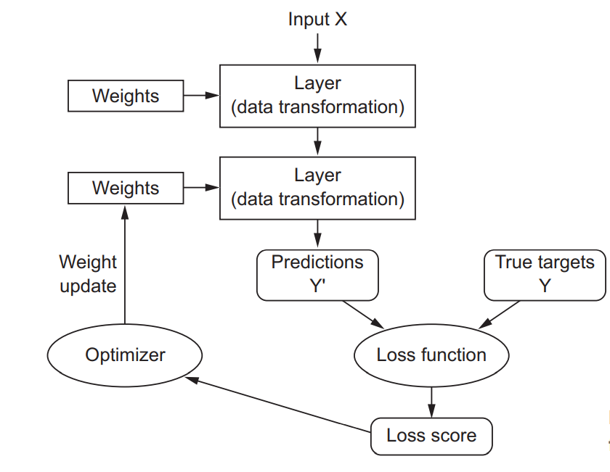
Working of Deep Learning

Slide 6
Convolutional Neural Network (CNN)
CNN is a type of deep learning model for processing data that has a grid pattern, such as images, which is inspired by the organization of animal visual cortex and designed to automatically and adaptively learn spatial hierarchies of features, from low- to high-level patterns. CNN is a mathematical construct that is typically composed of three types of layers (or building blocks): convolution, pooling, and fully connected layers. The first two, convolution and pooling layers, perform feature extraction, whereas the third, a fully connected layer, maps the extracted features into final output, such as classification. A convolution layer plays a key role in CNN, which is composed of a stack of mathematical operations, such as convolution, a specialized type of linear operation.

Slide 7
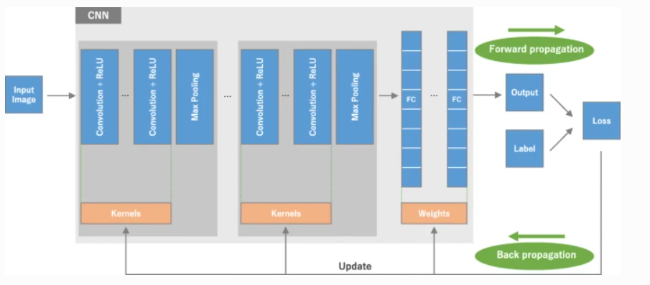

Slide 8
Flow Chart
Input
Data Preparation
Model Training
Testing
Output
Normal
AD Patient
Early detection of AD

Slide 9
Early Detection of Alzheimer’s Disease

Slide 10
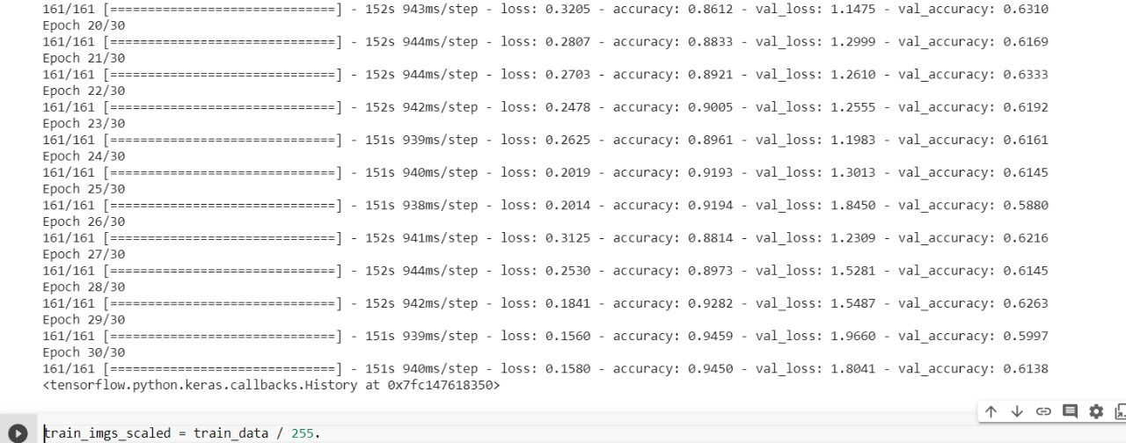
Training Accuracy and Validation Accuracy

Slide 11
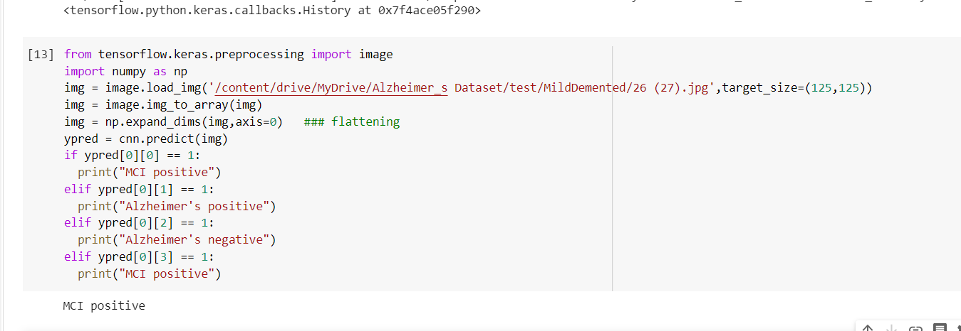

Slide 12
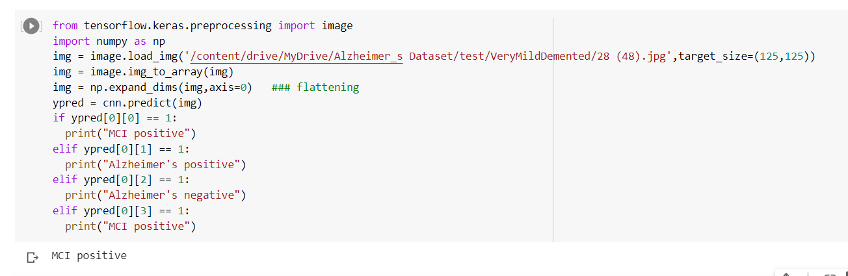

Slide 13
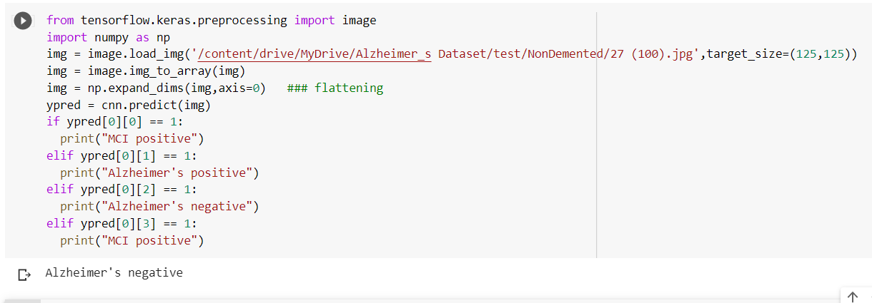

Slide 14


Slide 15
THANK YOU….!

